Slide 1
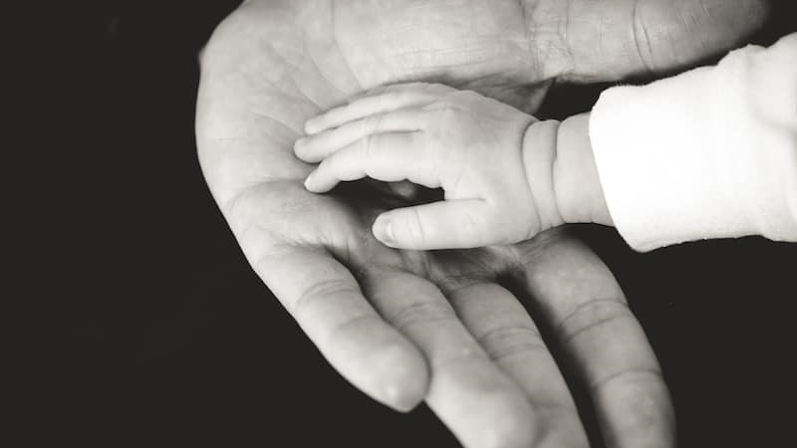

Helping Hands
Presented by Team SNS Nidhi Badde (001344844) Sanjana Anaokar (001304124)
Siddhant Rao (001051841)

Slide 2

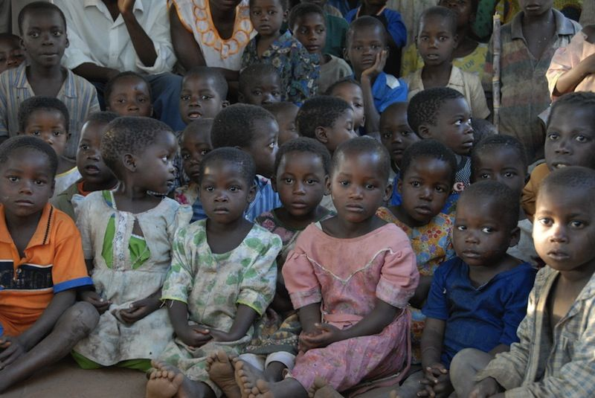
problem statement
According to UNICEF there are 140 million orphans in the world (survey done in 2015). Out of those 15.1 million have lost both their parents and are living in orphanage. Most researches have shown that these orphanages are not in proper condition or can provide the basic necessities to the children living in them.
Orphans are suffering through a lot in terms of coping up with this world. They are not just deficient of the love of the parents but other facilities as well such as health care (including both mental and physical health)
There are also various problems which are faced by children after adoption i.e. by adopter or parents who are interested to adopt them , as the thorough check and tracking is not done before handing them the child.

Slide 3

Solution to the problem
A good application is the one which tackles the day to day problems and comes up with a solution, in similar fashion there are various drawbacks at an orphanage, like high death rate due to disease ,lack of education and mental health issues .These problems of an orphanage management system can be well handled by proper supervision and this is where our application plays a significant role.
The application that is being developed would be able to aid these orphanages by coordinating with Orphanage Organizations , Hospitals and Adoption department to bring up the orphans and provide them the basic necessities .

Slide 4
Approach
We can also track all the background checks for an adopter who is willing to be a parent to the child. We can check if the parent is potential to adopt a child by performing criminal checks as well as finance background checks in this application.
Doctors are kept as different enterprise in which we can track all the problems by a child who is newly registered as well as wo is already a part of orphanage.

Slide 5
USE CASE DIAGRAMS

Slide 6
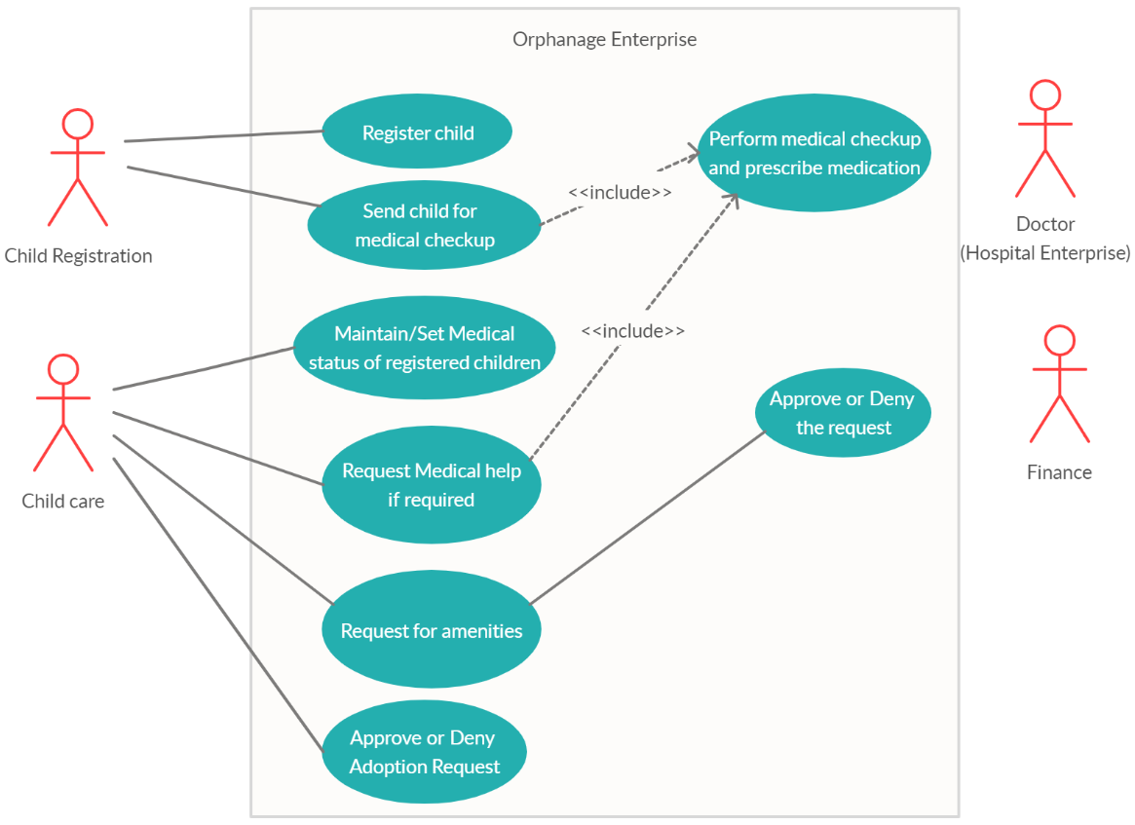
Use case diagram – Orphanage Enterprise

Slide 7
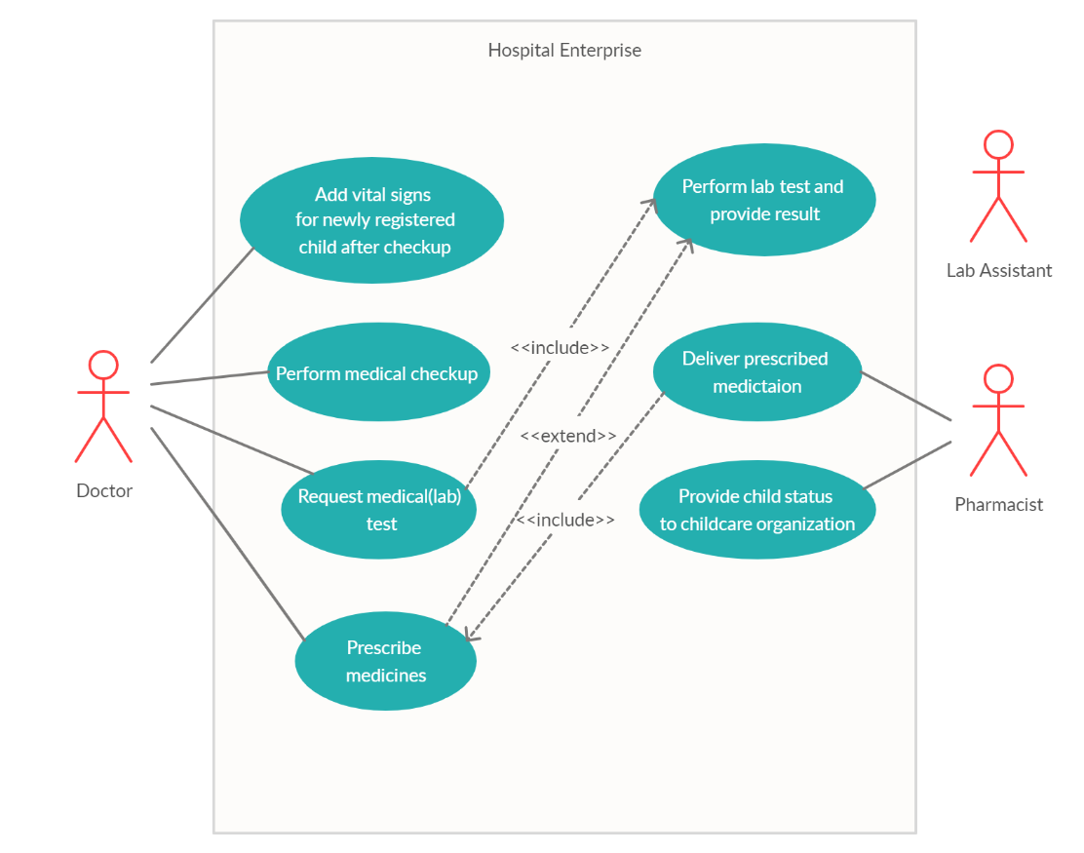
Use case diagram – Hospital Enterprise

Slide 8
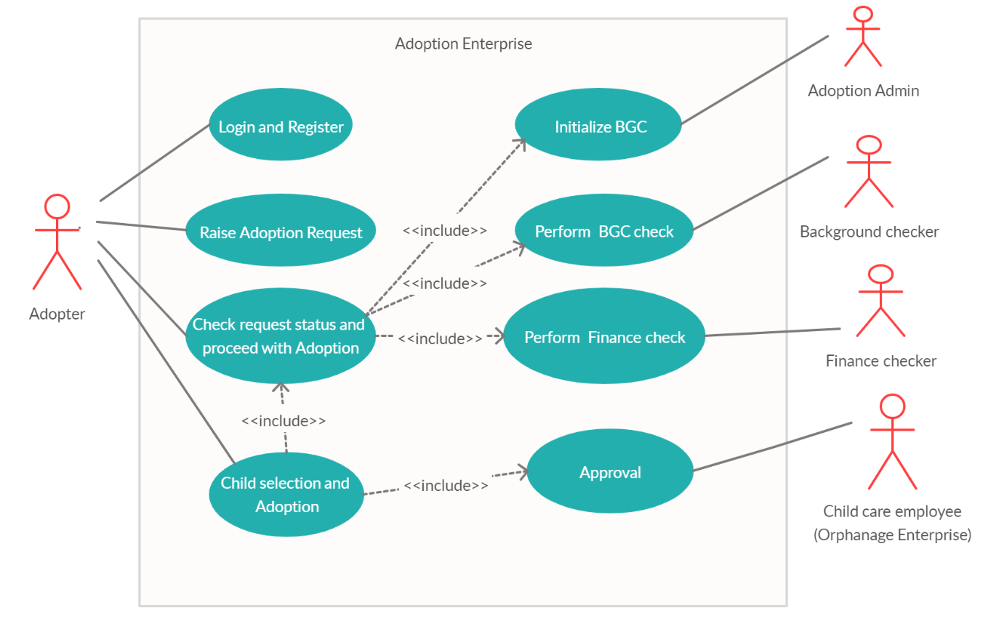
Use case diagram – Adoption Enterprise

Slide 9
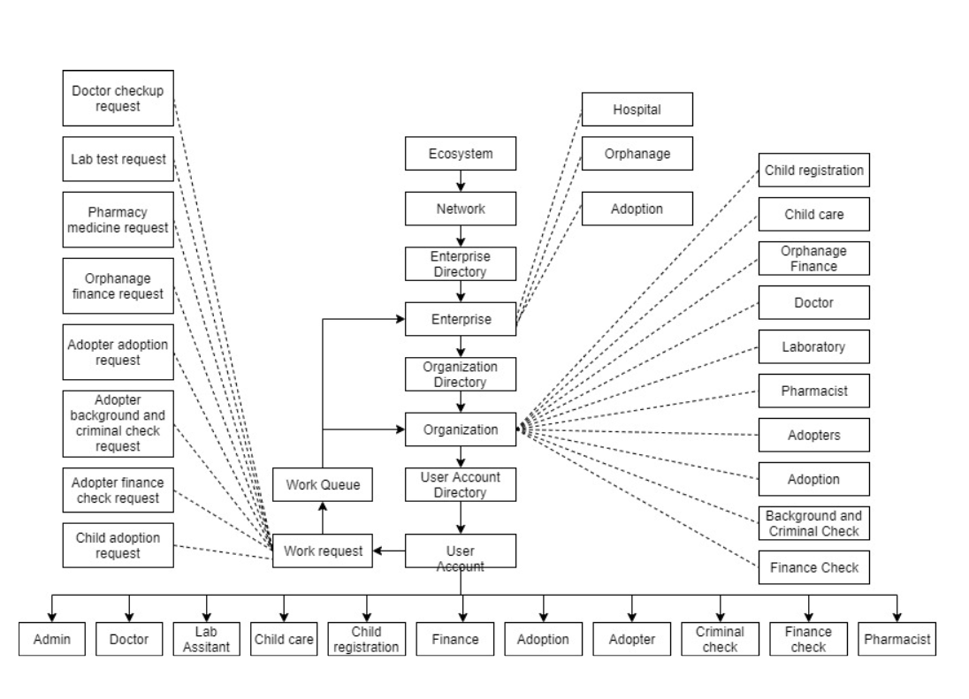
Design – Object Model Diagram

Slide 10
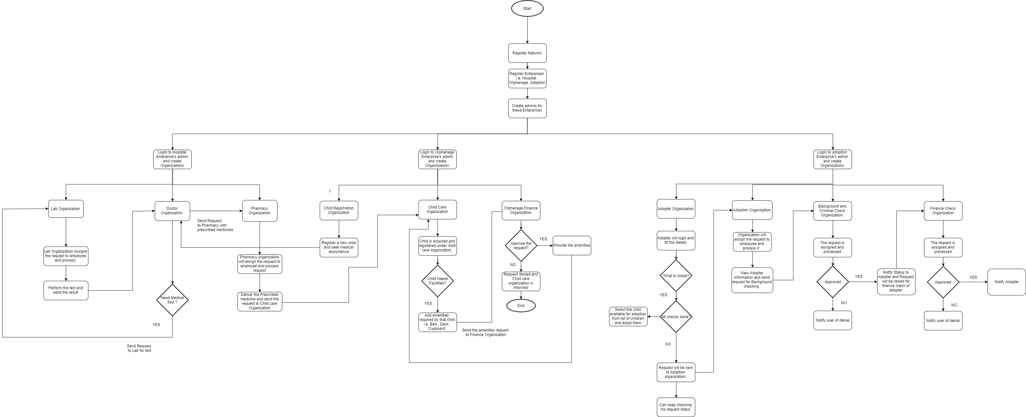
Work flow

Slide 11
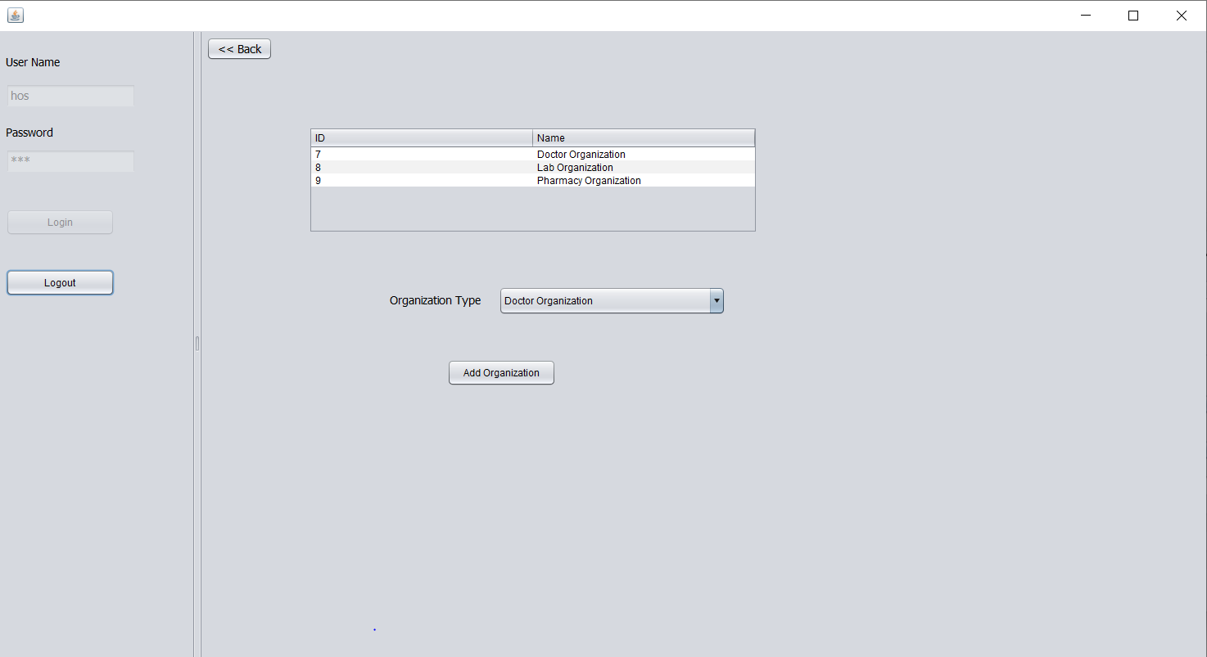
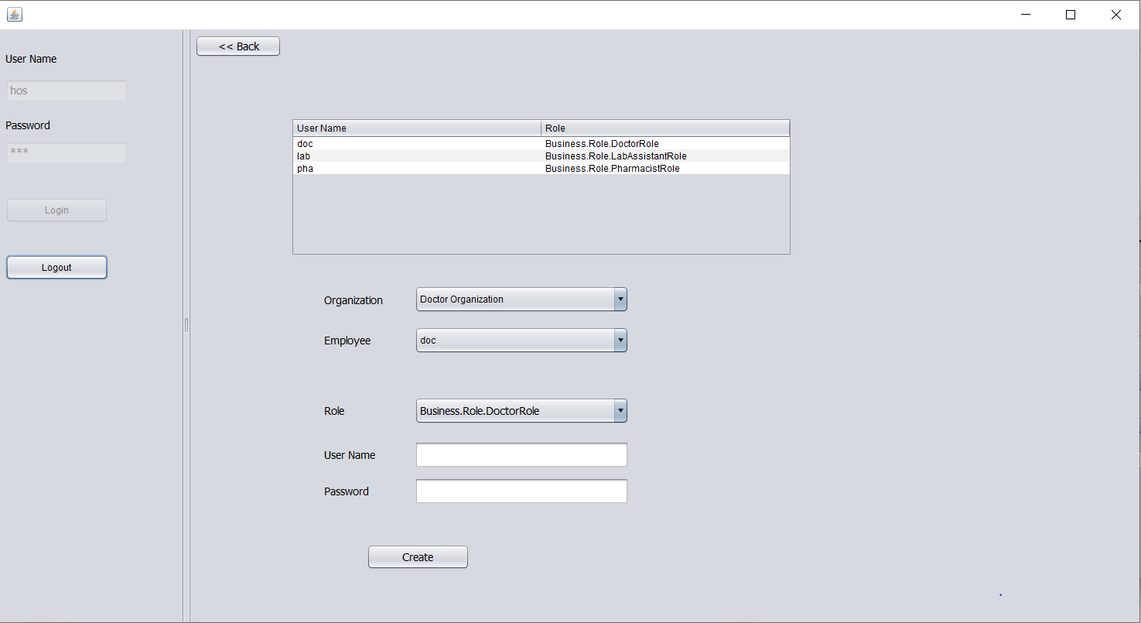
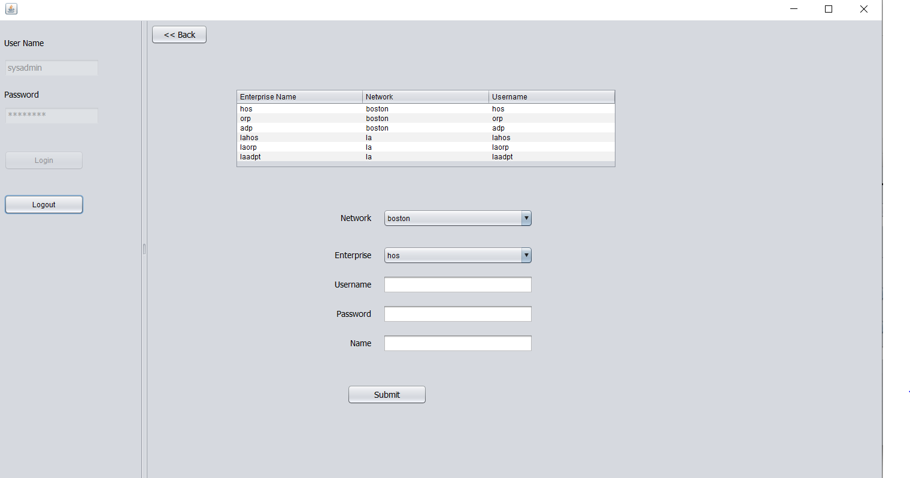
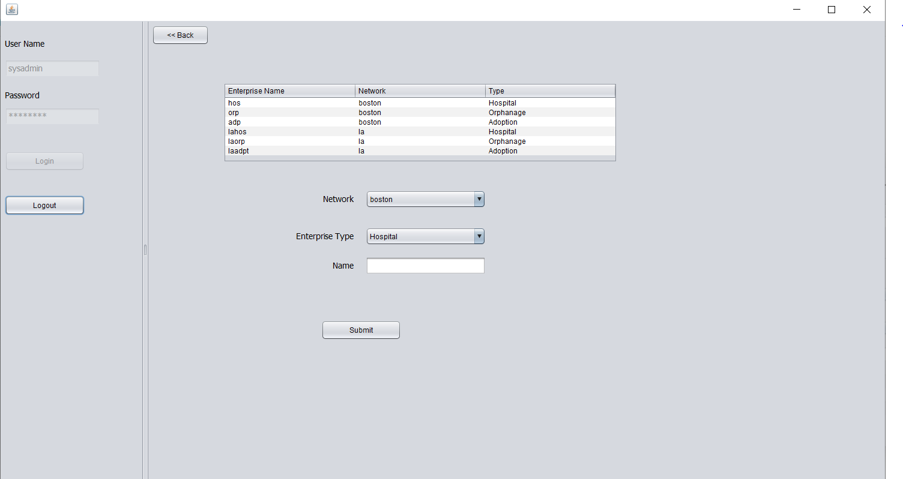
Key screenshot

Slide 12
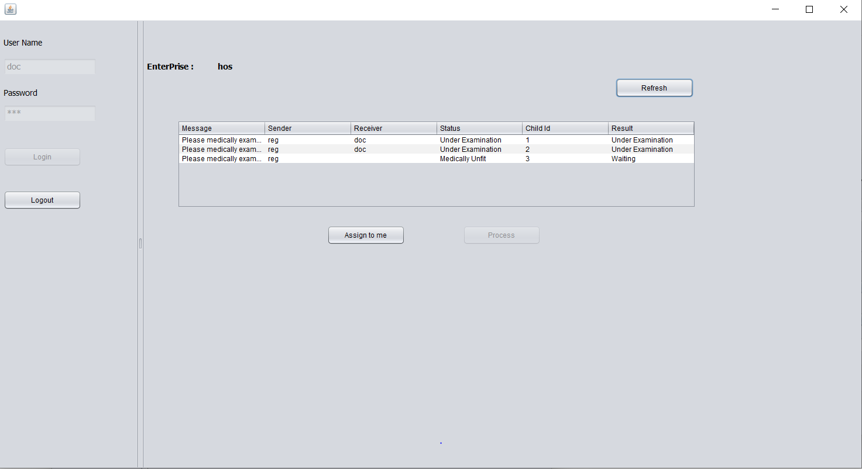
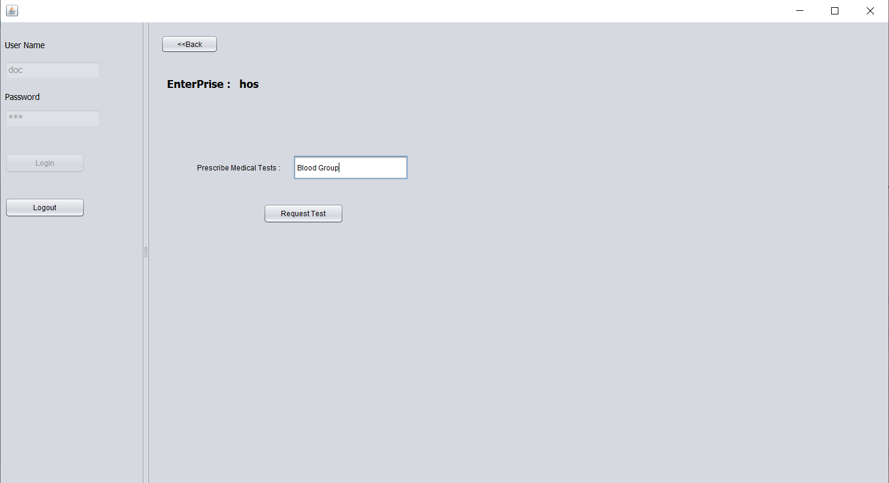
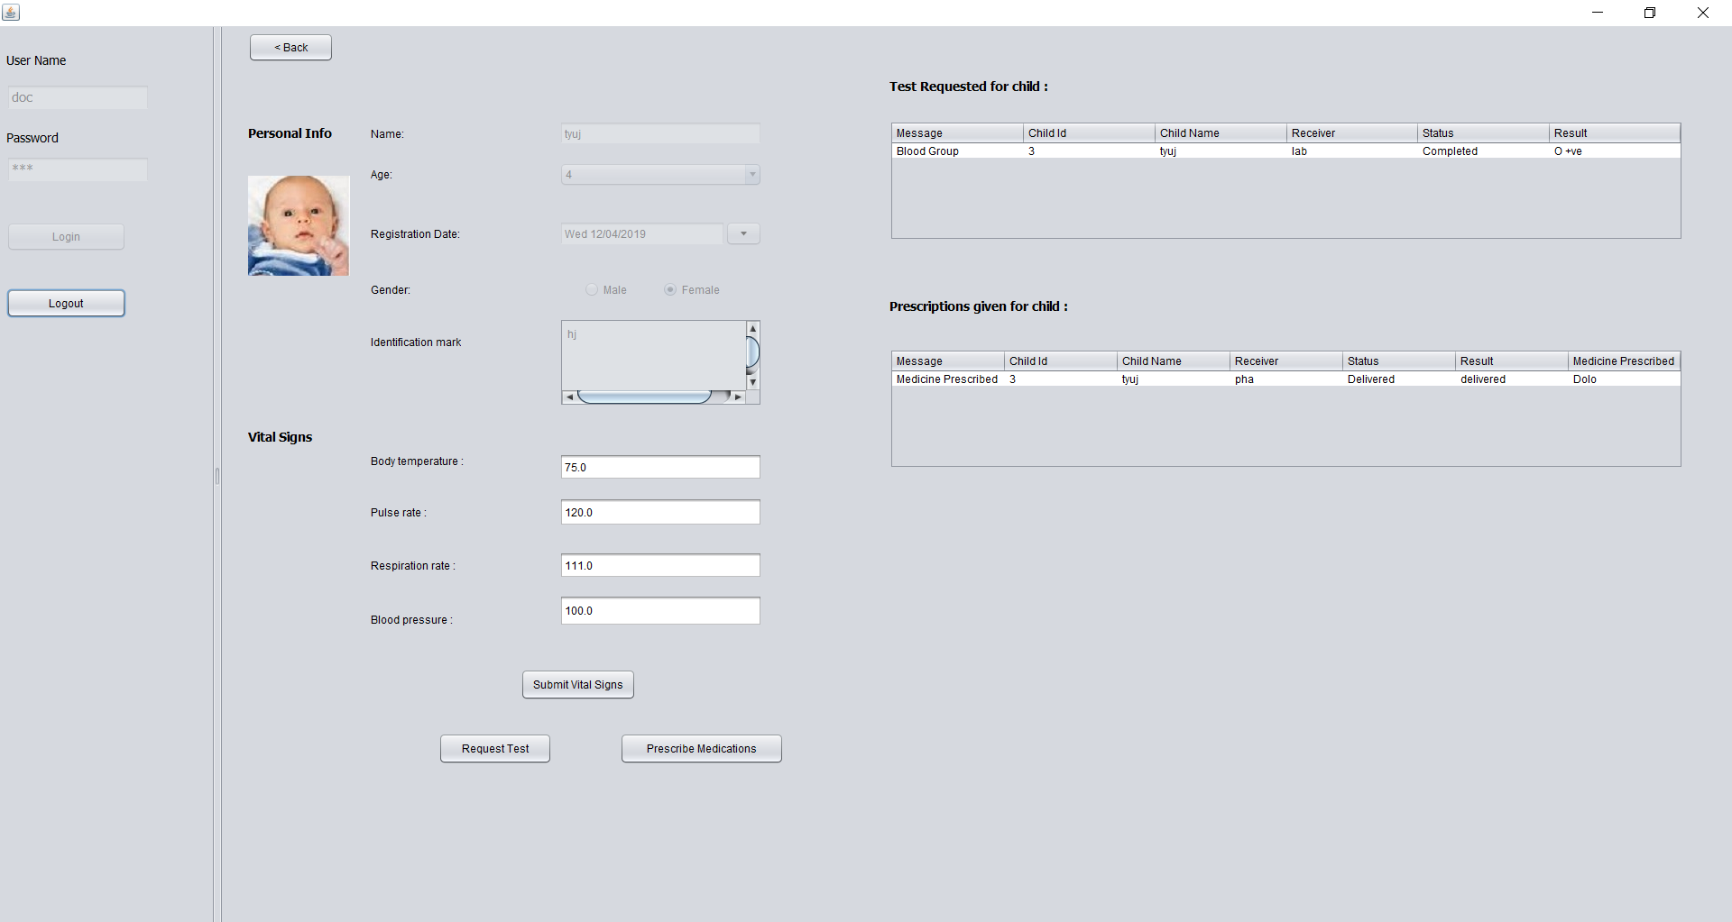
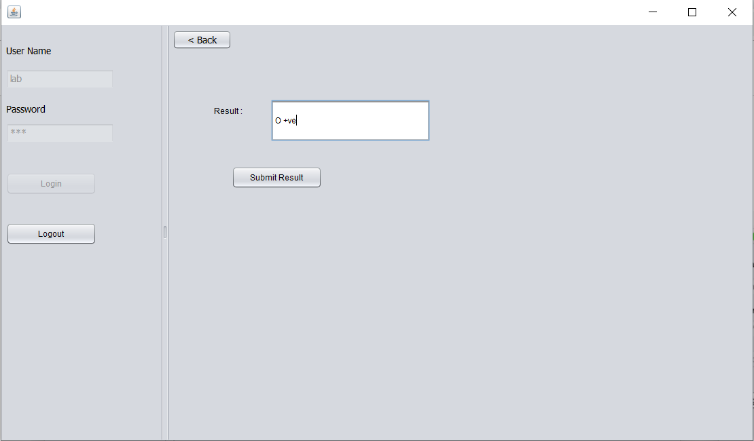
Hospital Enterprise

